Slide 1


Arizona NASA Space Grant Consortium Annual Statewide Student Research Symposium Casa Grande Union High School ASCEND HIGH ALTITUDE BALLOON PROJECT April 2023

Slide 2

Project Team
Project Manager: Jonathan Lawson
Science Principal Investigator: Valia Kaliotzakis
Payload Designer: Elias Razo
Control System/Software: Neal Allado
Electronic Systems Assembly: Ella Barth, Amaya Fisher
Fabrication/Assembly: Angel Gonzalez, Melody Limon, Elijah Ramirez
Data Analysis: Jacob Ross

Slide 3

Mission Statement
Our mission is to design and construct a payload capable of measuring ozone levels, having two experiments that involve particle capture in the stratosphere using aerogel, and examining the growth of E. coli in correlation with gamma radiation levels.

Slide 4

DESIGN

Slide 5
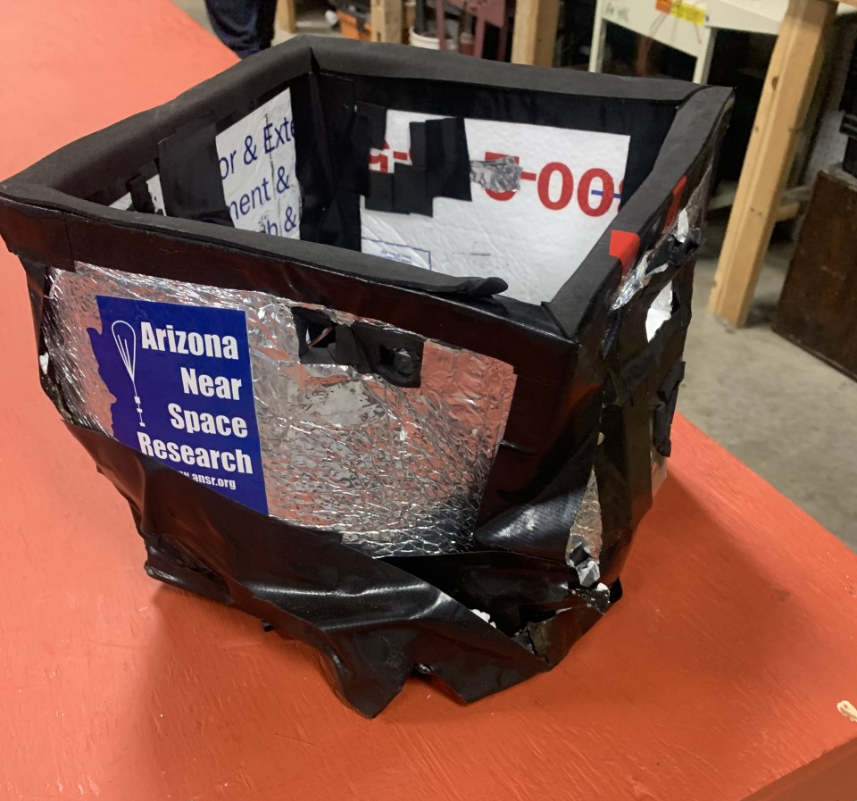
Fall Semester Enclosure
(Post Recovery)

Slide 6
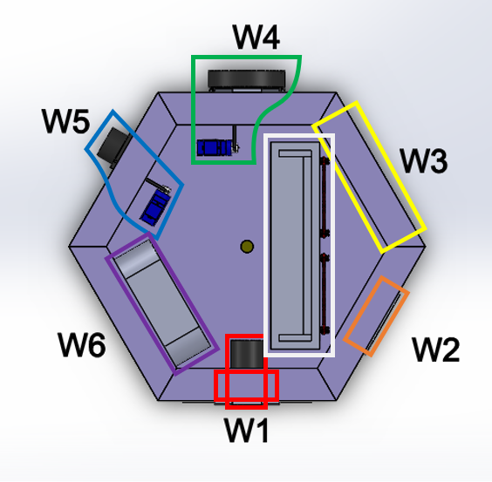
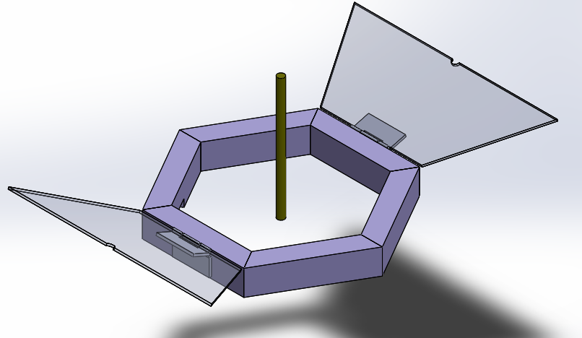
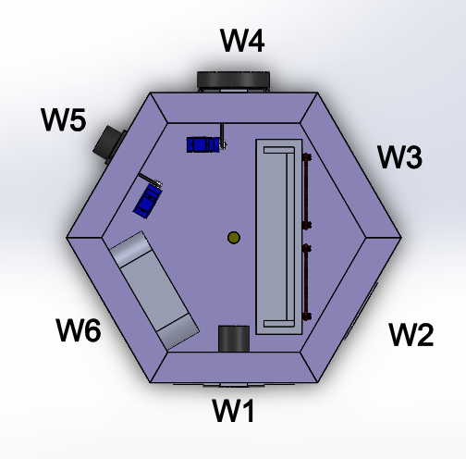
Spring Semester Enclosure Design

Slide 7
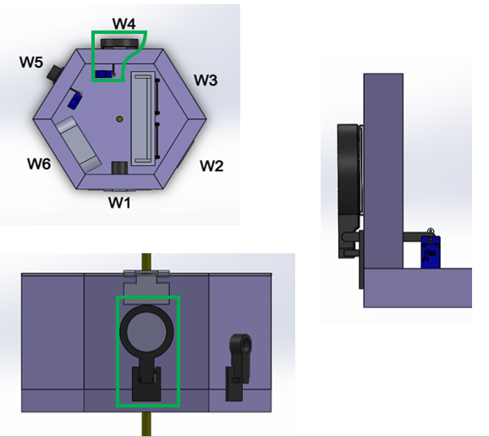

Petri Dish Mechanism
Components:
Petri Dish Holder
Hinge
Connecting rod
Servo
Petri Dish

Slide 8
Fabrication

Slide 9


Construction Materials
EPS Rigid Foam Board Insulation, 1 ” thick
LEXAN General Purpose 3/16 in. thick polycarbonate non-UV coated sheet
3D printed parts
Gorilla Wood Glue
Gorilla Duct Tape

Slide 10
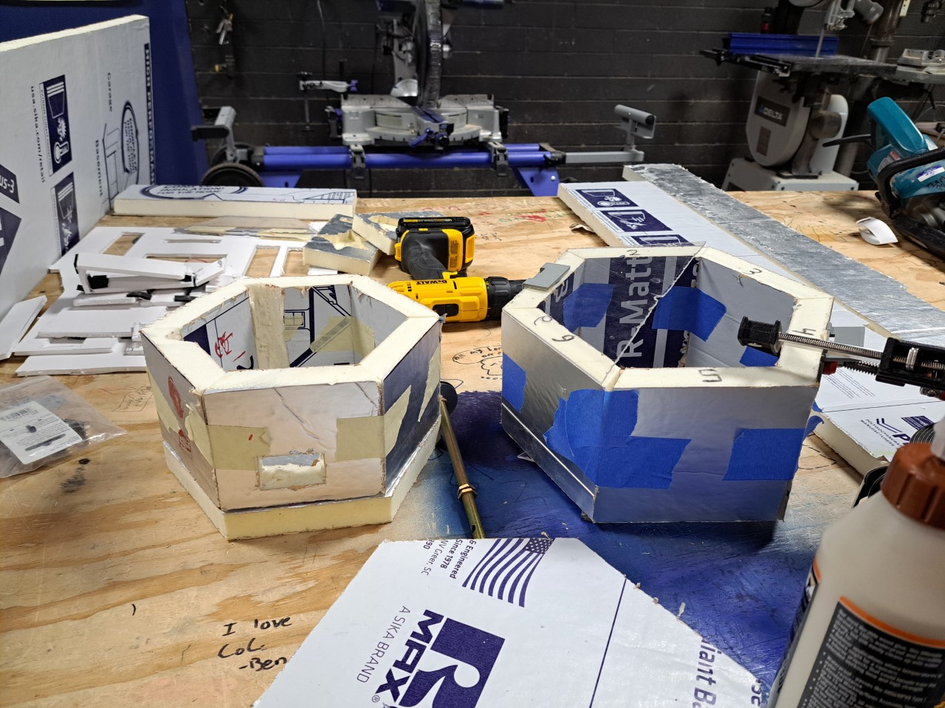

Slide 11
Electrical Systems

Slide 12
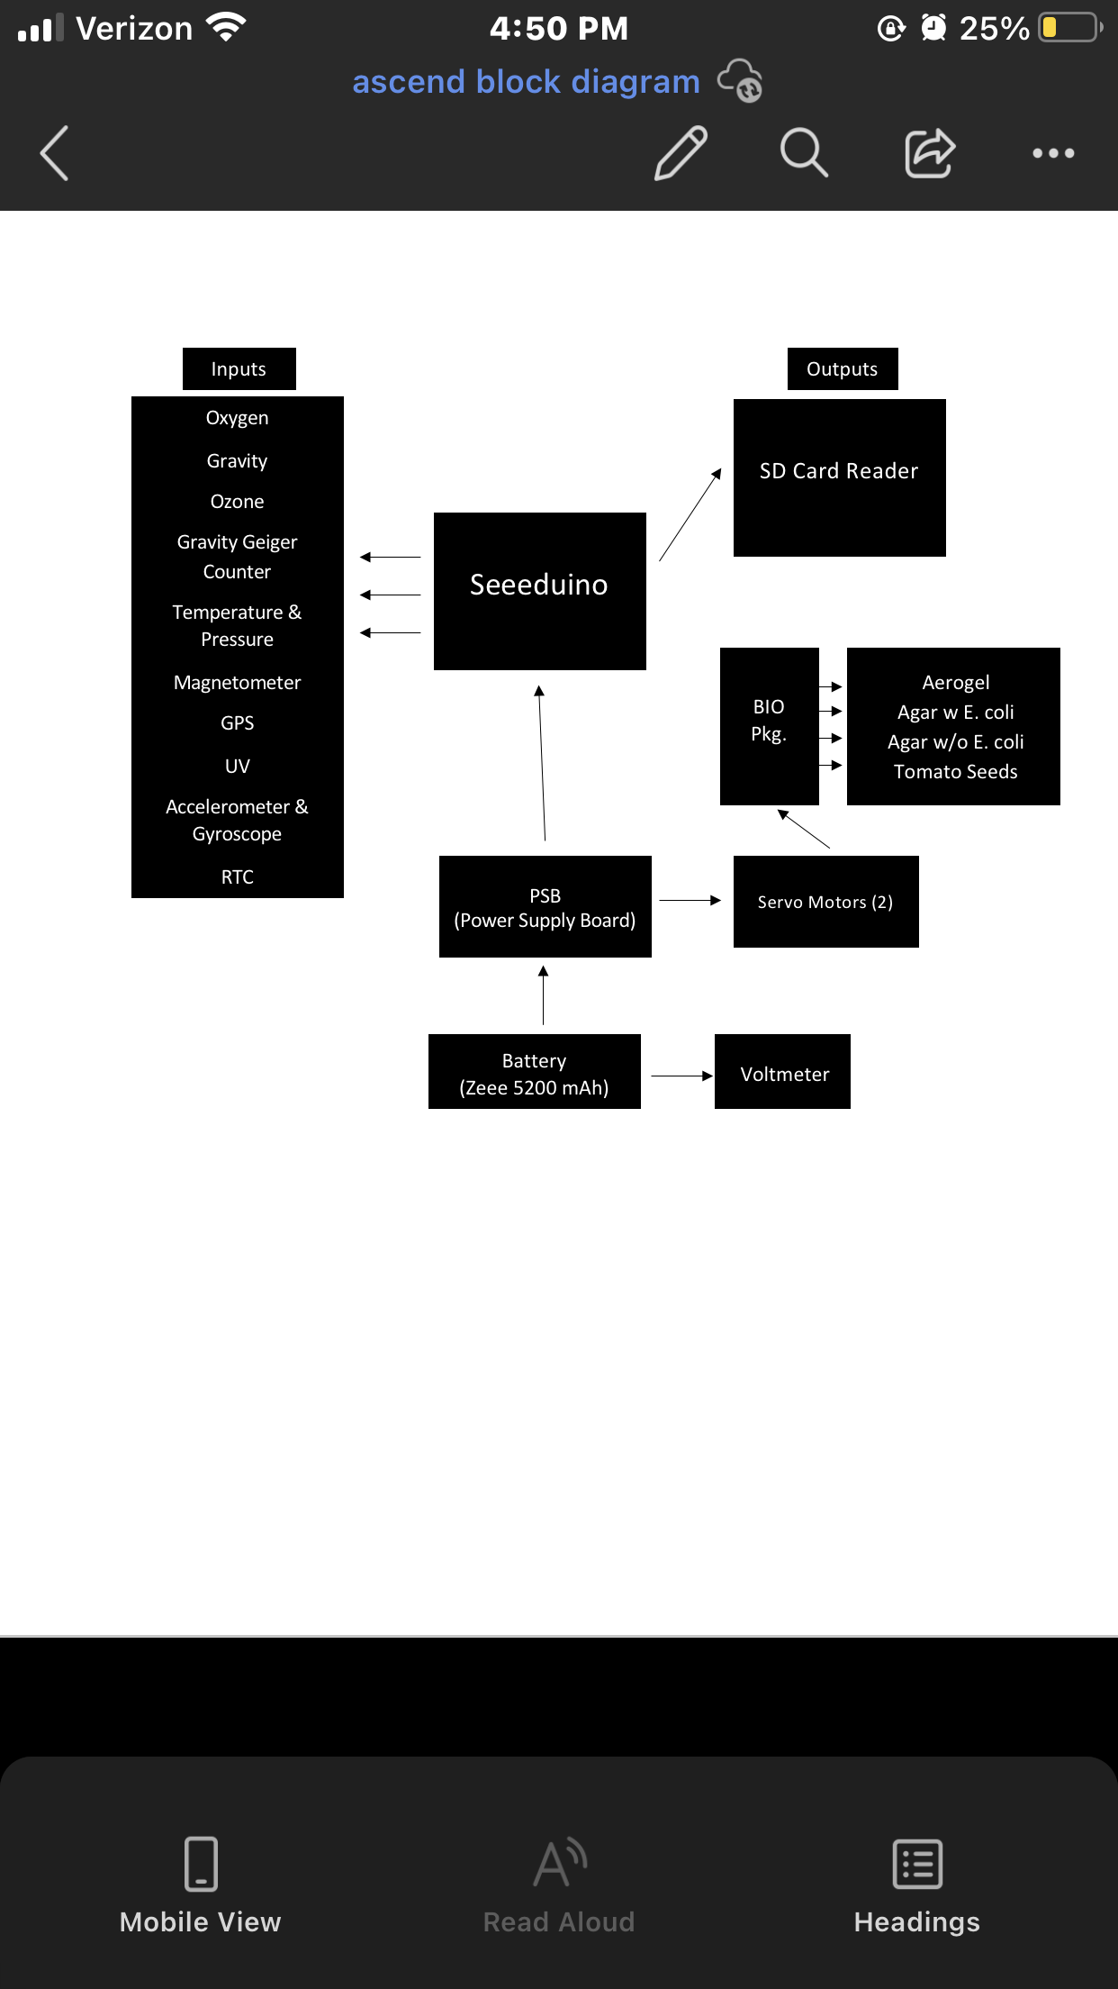
Electrical Block Diagram

Slide 13
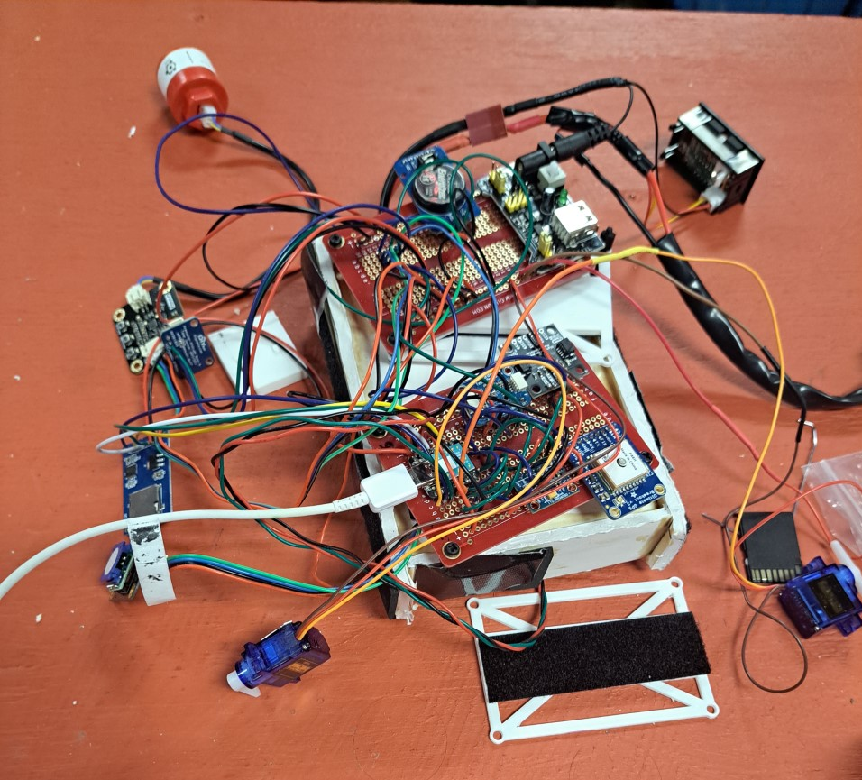


Slide 14
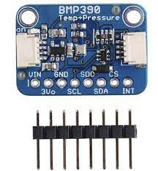
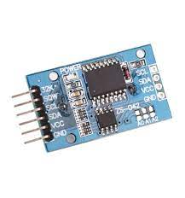
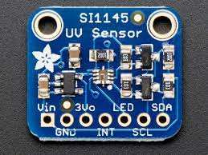
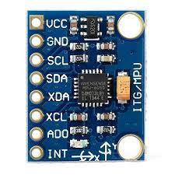
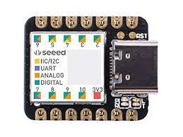
BMP390
RTC ds3231
MPU6050
SI1145
Seeeduino Xiao

Slide 15
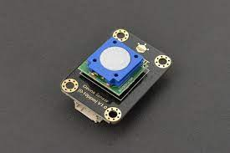
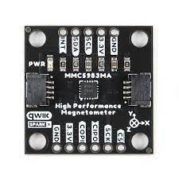
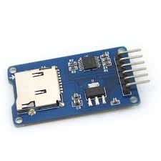
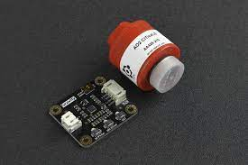
Ozone Sensor
MMC5983
MicroSD Breakout Board
Oxygen Sensor

Slide 16
Control System Software Development

Slide 17
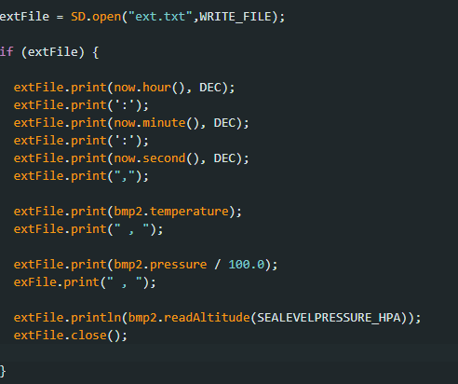
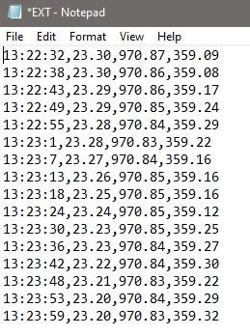

Slide 18
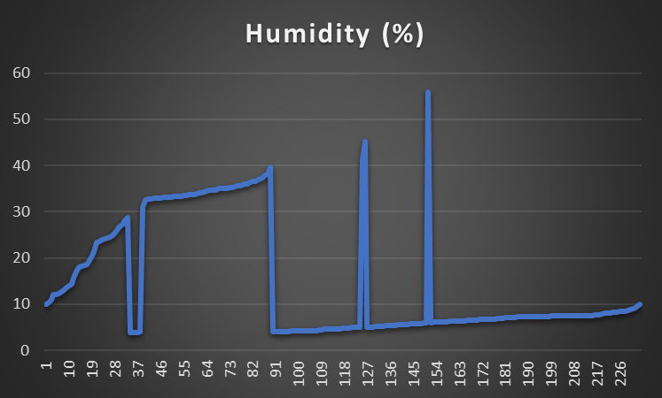
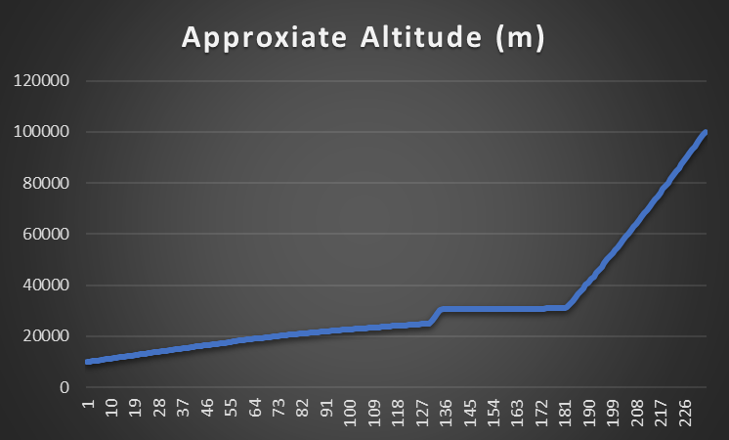
Data From
Fall 2022

Slide 19
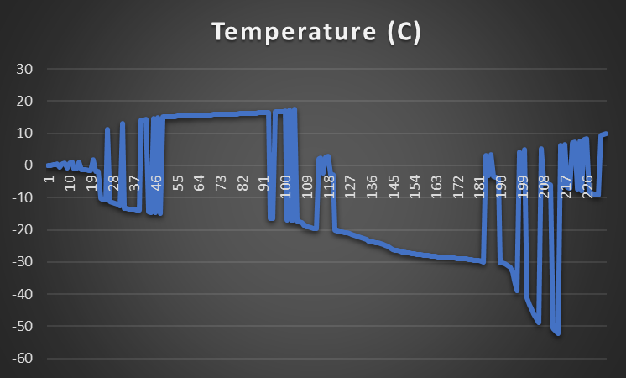
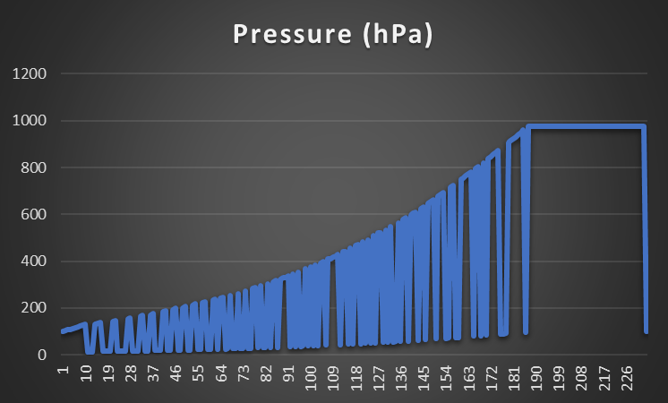
Data From
Fall 2022

Slide 20
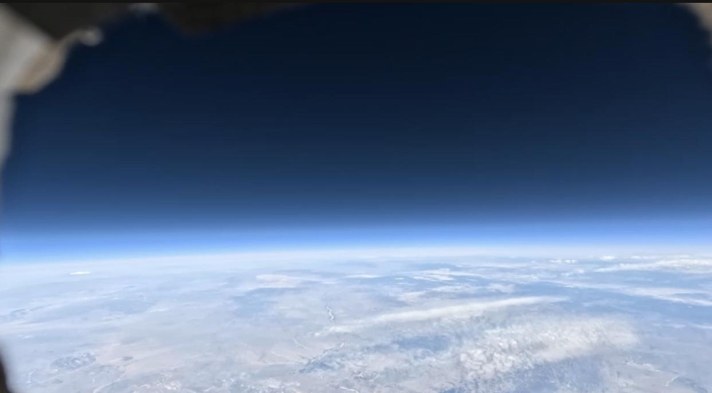

Slide 21
Bioscience

Slide 22
Biological Experiments Summary
Project 1: Aerogel - Objectives: capture any particles floating in the atmosphere.
Project 2: LB Agar Dish With E. Coli - Objectives: Identify if any microorganisms can cultivate and sustain growth in microgravity conditions.
Project 3: Beefsteak Tomato Seeds - Objectives: Identify what genetic effects radiation has on crops.
Project 4: Petri Dish with LB Agar - Objectives: Capture and Identify potential bacteria strains found in the atmosphere.

Slide 23
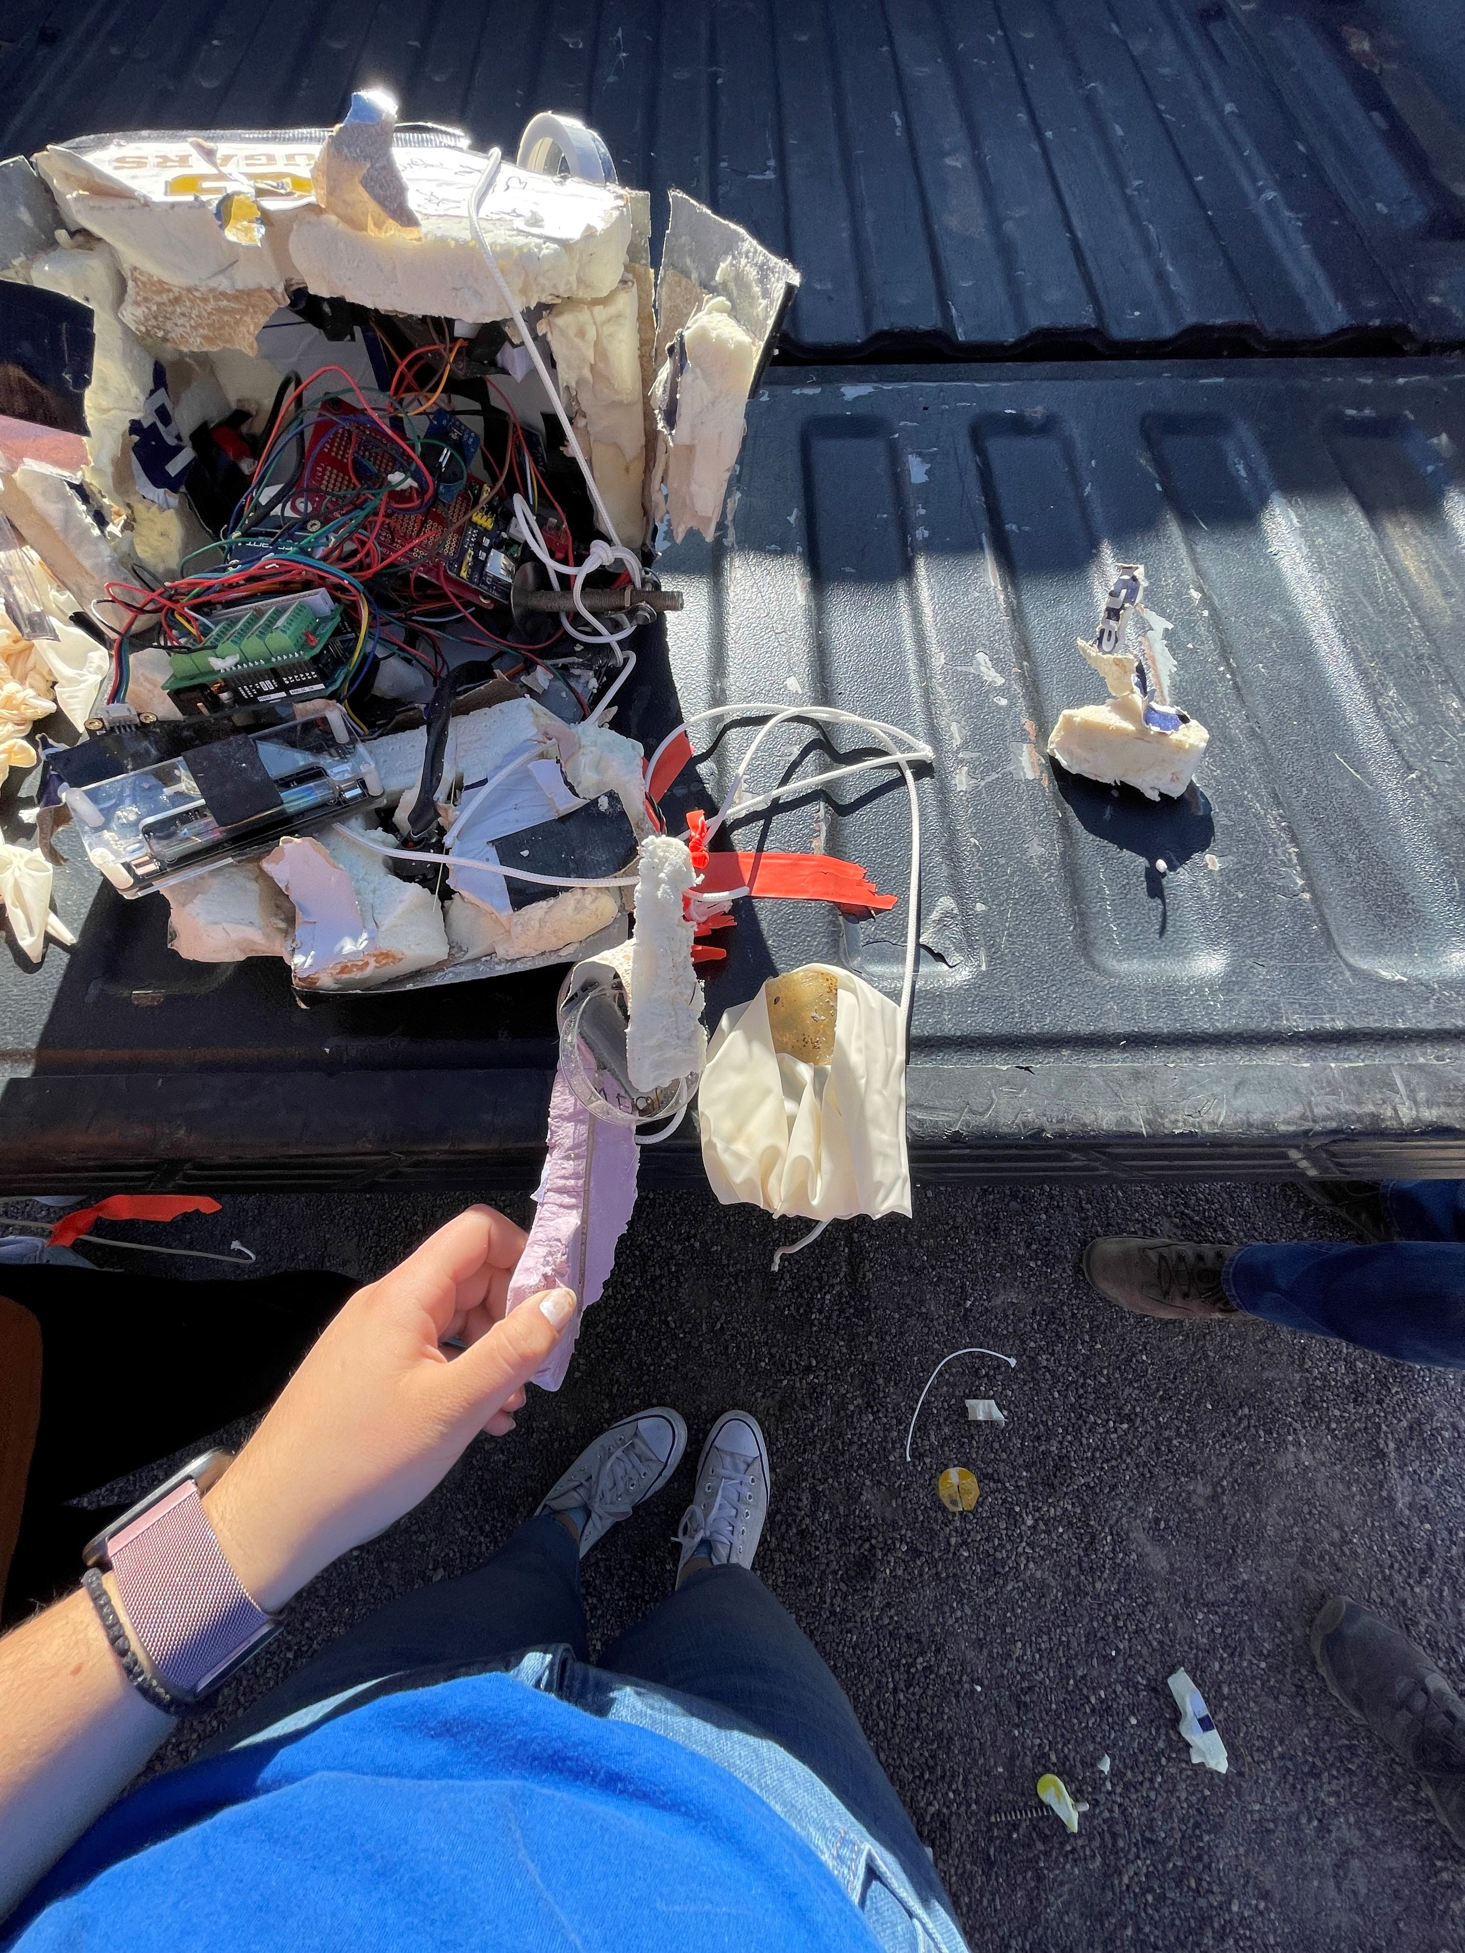
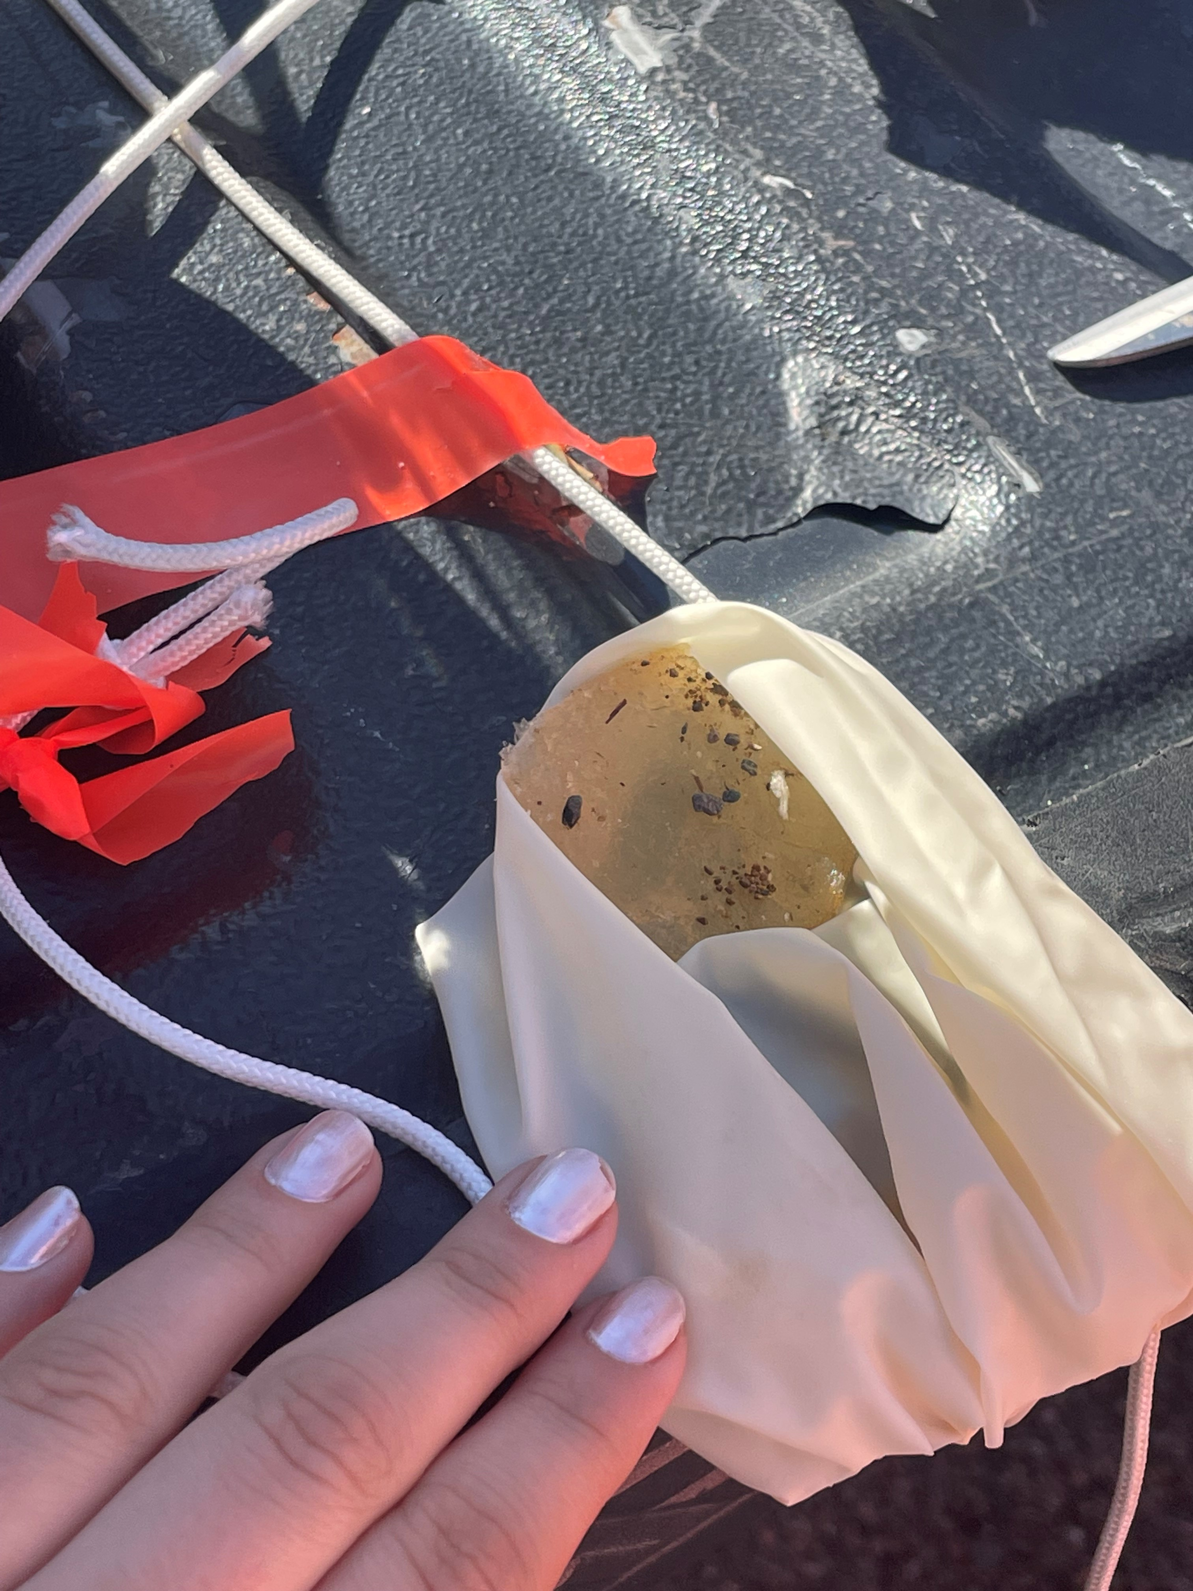
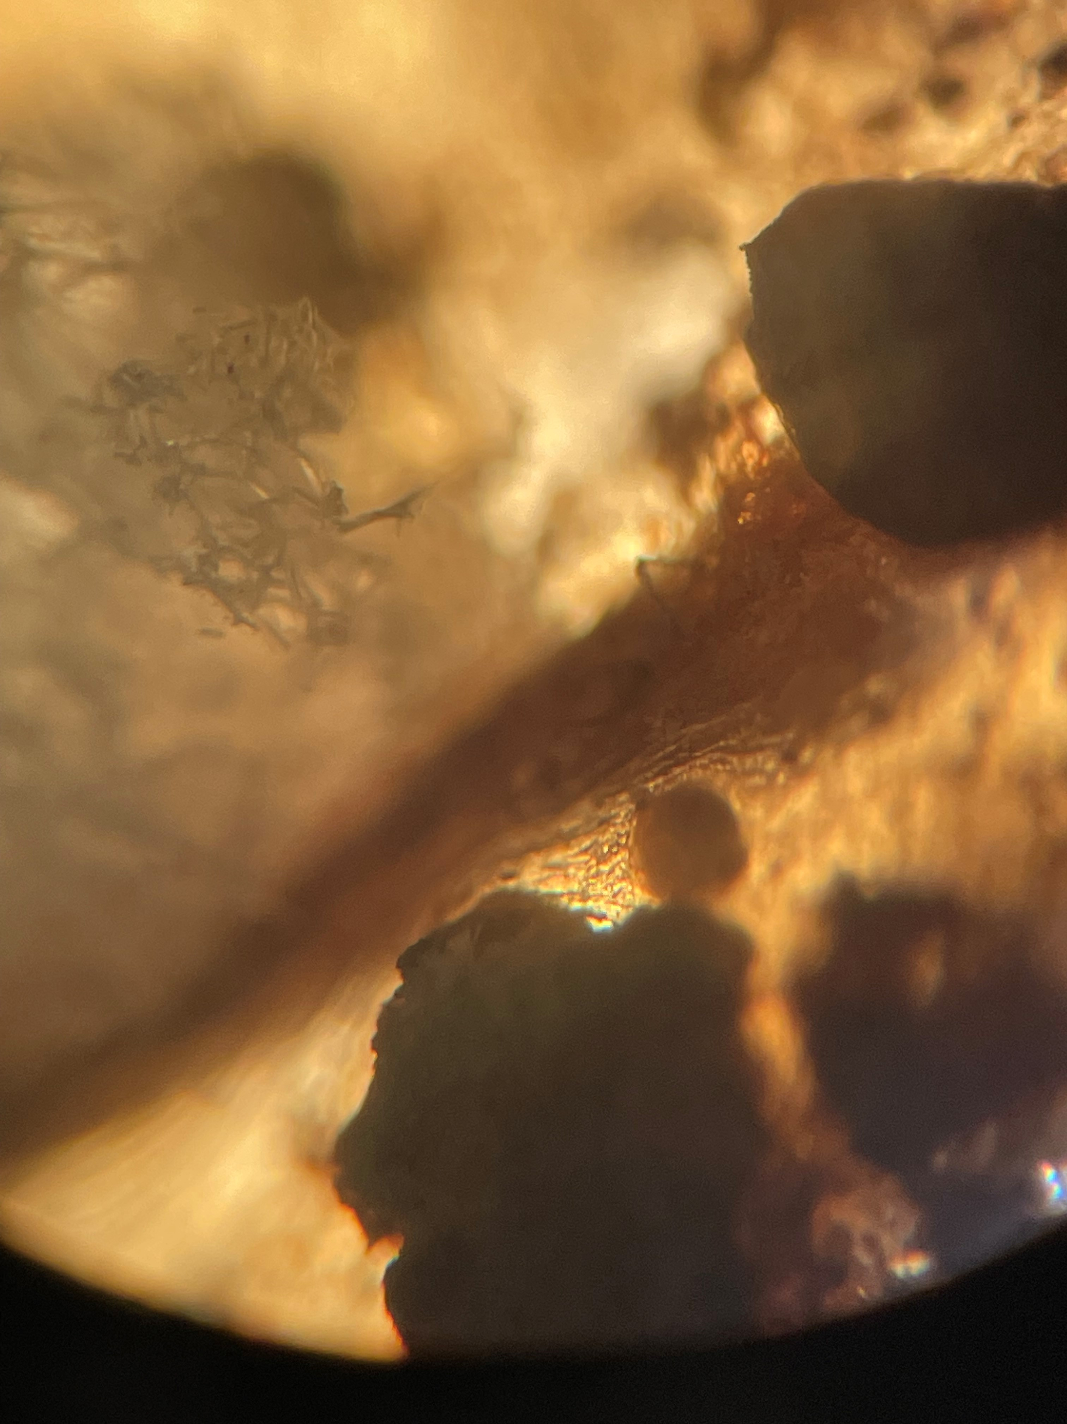
Post-Launch Results

Slide 24
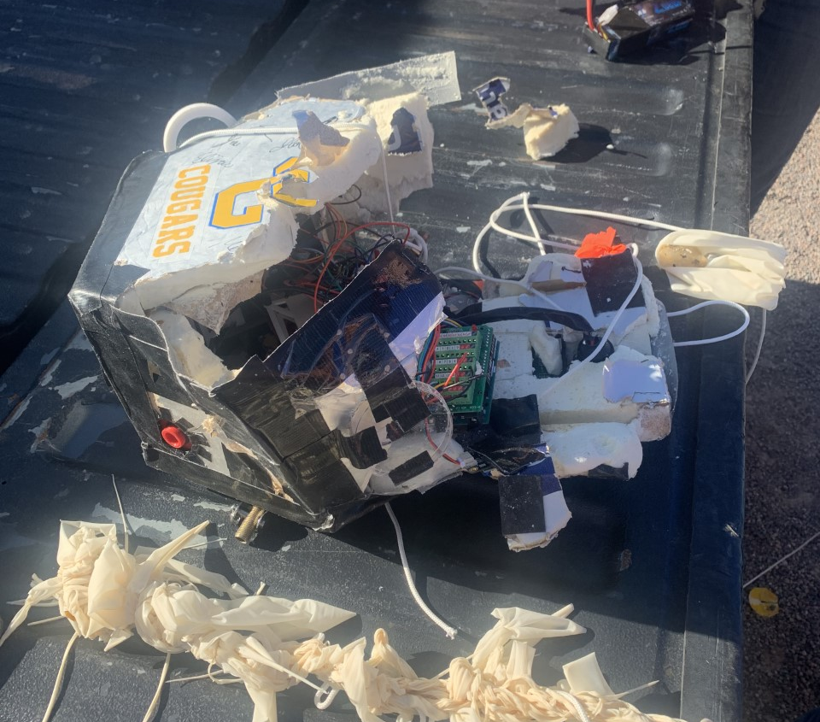
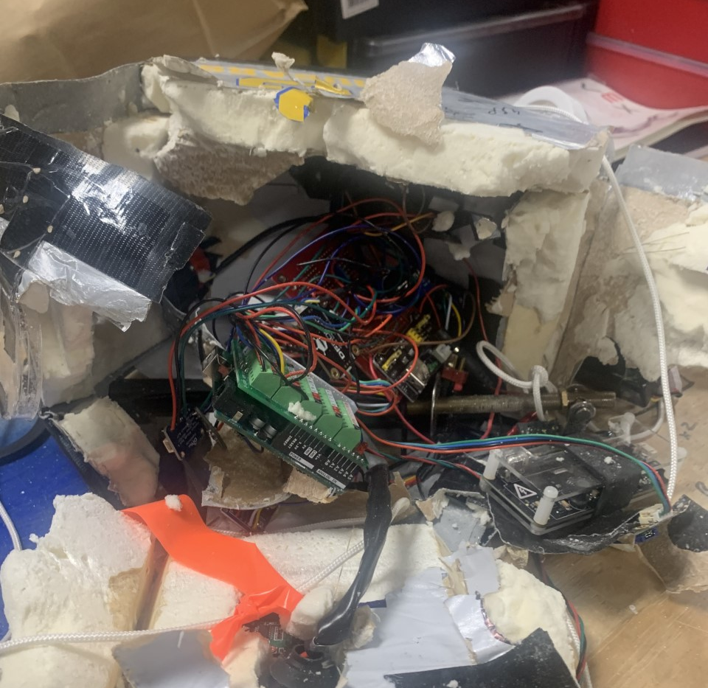

Slide 25
Acknowledgements
Michelle Coe, Manager
Arizona/NASA Space Grant Program
University of Arizona
Clayton G. Jacobs, KJ6QJS
President, Arizona Near Space Research www.ansr.org
Stephen Thomas, KE7TLS,
Vice President, Arizona Near Space
Shirley Campbell, Assistant Director
National Space Grant Foundation
John Morris
Certified Educator
Engineering | Software and App Design

Slide 26




Thank you!

